Slide 1
HealthyGrowth Midterm
Project coordinator Egon Noe
European CORE Organic Research
1 October 2013
Stockholm, Sweden

Slide 2
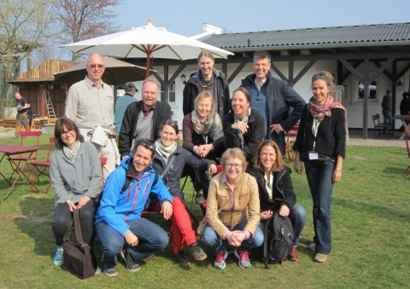
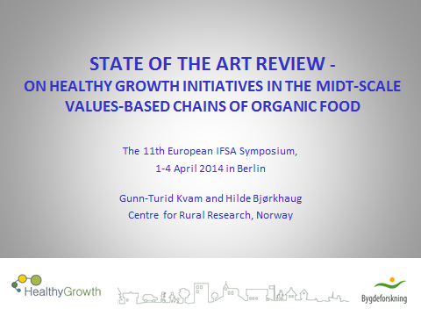
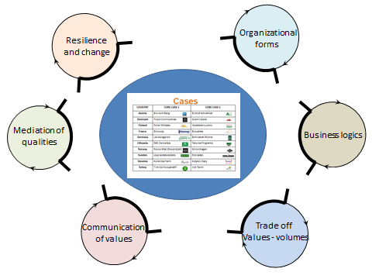
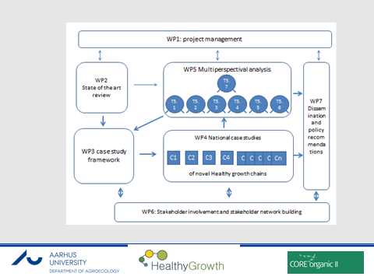
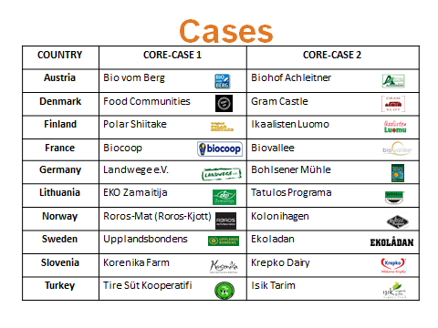
 |  | Acronym | Organisation | Country | Contact person
1 | Coordinator | AU-AGRO | Aarhus University | Denmark | Assoc. Prof. Egon Noe
2 | Partner | KTH | Royal Institute of Technology | Sweden | Assoc. Prof. Rebecka Milestad
3 | Partner | INRA SAD | INRA | France | Dr. Claire Lamine
4 | Partner | CRR | Centre for Rural Research | Norway | Dr., senior researcher Hilde Bjørkhaug
5 | Partner | FALS | University of Maribor, Faculty of Agriculture and Life Sciences | Slovenia | Assoc. Prof. Andreja Borec
6 | Partner | UIBK | University of Innsbruck | Austria | Assoc. Prof. Markus Schermer
7 | Partner | SDU | Suleyman Demirel University | Turkey | Assistant prof. Handan Giray
8 | Partner | MTT | MTT Agrifood Finland | Finland | PhD, senior researcher Helmi Risku-Norja
9 | Partner | HNEE | Uni. of Appl. Sciences in Sustain- able Development in Eberswalde | Germany | Dr., senior researcher Susanne von Muenchhausen
10 | Partner | MARIM | GDAR Fruit Growing Research Station Manager | Turkey | Dr., researcher Adem Atasay
11 | Partner | LAEI | Institute of Agrarian Economics | Lithuania | Dr. Virgilijus Skulskis
From niche to volumen with integrity and trust
Project coordinater Egon Noe,
Department of Agroecology, Aarhus University, Denmark
Information Bazar European CORE Organic Research 1 October 2014, Stockholm, Sweden

Slide 3
Consortium
 |  | Acronym | Organisation | Country | Contact person
1 | Coordinator | AU-AGRO | Aarhus University | Denmark | Assoc. Prof. Egon Noe
2 | Partner | KTH | Royal Institute of Technology | Sweden | Assoc. Prof. Rebecka Milestad
3 | Partner | INRA SAD | INRA | France | Dr. Claire Lamine
4 | Partner | CRR | Centre for Rural Research | Norway | Dr., senior researcher Hilde Bjørkhaug
5 | Partner | FALS | University of Maribor, Faculty of Agriculture and Life Sciences | Slovenia | Assoc. Prof. Andreja Borec
6 | Partner | UIBK | University of Innsbruck | Austria | Assoc. Prof. Markus Schermer
7 | Partner | SDU | Suleyman Demirel University | Turkey | Assistant prof. Handan Giray
8 | Partner | MTT | MTT Agrifood Finland | Finland | PhD, senior researcher Helmi Risku-Norja
9 | Partner | HNEE | Uni. of Appl. Sciences in Sustain- able Development in Eberswalde | Germany | Dr., senior researcher Susanne von Muenchhausen
10 | Partner | MARIM | GDAR Fruit Growing Research Station Manager | Turkey | Dr., researcher Adem Atasay
11 | Partner | LAEI | Institute of Agrarian Economics | Lithuania | Dr. Virgilijus Skulskis

Slide 5
HealthyGrowth: From niche to volumen with integrity and trust
Main rationale of HealthyGrowth:
That a healthy and sustainable growth in the organic market depends on the ability of market chains to combine volume and values, with measures that secure integrity and trust based on the organic values and principles, and thereby generating a prize premium that can be distributed along the chain.

Slide 6
The main hypotheses:
Mid-scale value chains operate by a different marketing logic than either small- or large-scale chains, based on different forms of organisations, partnerships and strategies
that this enables them to combine growth in volume with a high and growing level of organic values throughout the market chain as a sound foundation for organic integrity and consumer trust

Slide 7
The aim:
is to study a range of successful mid-scale food value chains
and show the fundamental prerequisites for their success in combining volume and values
in order to support the development of new organic value chains and provide new opportunities for organic actors.

Slide 9
STATE OF THE ART REVIEW - ON HEALTHY GROWTH INITIATIVES IN THE MIDT-SCALE VALUES-BASED CHAINS OF ORGANIC FOOD
The 11th European IFSA Symposium,
1-4 April 2014 in Berlin
Gunn-Turid Kvam and Hilde Bjørkhaug
Centre for Rural Research, Norway
Notes:
Introduksjonsforelesning for masterstudenter

Slide 10
CONCLUSIONS
Emphasize a diversity of values and product qualities far beyond organic standard
Many chains access a diversity of sale channels, both direct and indirect channels
Utilize a diversity of means to communicate values and product qualities to consumers
Emphasize personal relationships between chain actors for building trust and common values along the chain - secure communication of product qualities
Established a diversity of organizational forms/structures, - forms of producer organizations common in a majority of chains

Slide 11
DIFFERENTIATION STRATEGIES FOR HEALTHY GROWTH

Slide 12
Organizational
forms
Resilience
and change
Mediation of
qualities
Business logics
Communication
of values
Trade off
Values - volumes

Slide 13
Some mid-term reflection
The multi-perspectival approach is very inspiring, mobilises the skills and ownership of all the partners.
Takes a lot of project coordination (challenge of the ERA-net construction)
Organic actors are very busy. Draw on interaction with existing networks.
In terms of sustainable development organic shall be understood as framework for qualities/values more than a specific quality

